Slide 1
Invest in the Region’s
Flagship Places
Moderator: Hope Knight, President & CEO, Greater Jamaica Development Corporation, @GJDCPrez
Laura Curran, County Executive, Nassau County, New York
Lynn Haig, Director of Planning, Office of Planning & Economic Development, City of Bridgeport, Connecticut, @CityofBptCT
Melissa Mark-Viverito, Senior Advisor, Latino Victory Fund; former New York City Council Speaker, @MMViverito
David Martin, Mayor, Stamford, Connecticut, @StamfordMayor
Notes:
PM / Carnegie

Slide 2

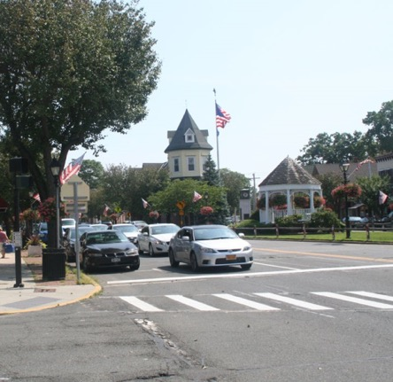
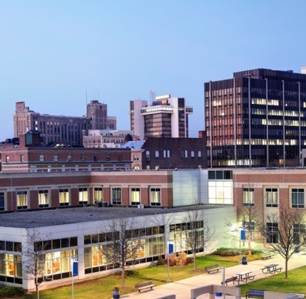
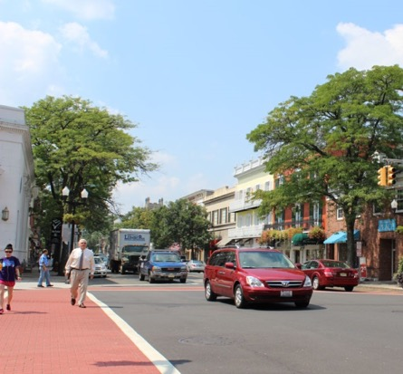

Invest in the Region’s Flagship Places
April 27, 2018
Melissa Kaplan-Macey, AICP
Director, Connecticut

Slide 3
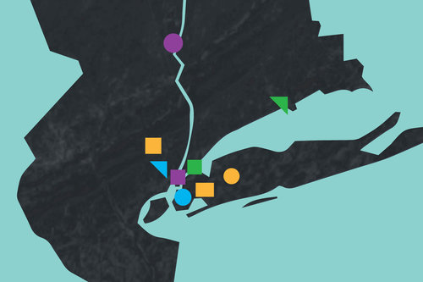

On the ground in the region…
The Fourth Regional Plan-
    Increasing economic opportunity
    Addressing displacement
    Improving mobility
    Adapting to climate change
What the Plan looks like in cities & neighborhoods
How can it help places achieve their visions for the future
Notes:
The Fourth Plan has over 60 policy recommendations aimed to increase economic opportunity, address displacement, improve mobility and adapt to climate change.
But what does the Plan really mean on the ground in our cities, towns and neighborhoods?
Making meaning of the plan and making it actionable on the local level is essential to realizing our vision for the region’s future.
This panel will explore the idea of -
“what does the Fourth Plan looks like in cities and neighborhoods?” and
How it can help Places achieve their visions for the future?
Places like:
Jamaica, Queens
The Inner Long Island Sound
The Nassau Hub on Long Island; and
Stamford & Bridgeport, Connecticut
The Fourth Plan proposes a vision for the future of these places-
What do the people who are working to effect change in these places every day think about the future vision the plan proposes?
How does the plan help?
And what needs to be done to move the ball down the field towards a vision for the future?
I’m going to take you quickly through some images that illustrate the Fourth Plan’s vision for these places, before turning the mic over to our panelists, who will share their reactions to these ideas and talk about the opportunities and challenges that they see in achieving the Fourth Plan’s vision for the future.
Our moderator: Hope Knight, President & CEO of Greater Jamaica Development Corporation
Melissa Mark-Viverito, Senior Advisor for the Latino Victory Fund and former New York City Council Speaker
Laura Curran, County Executive for Nassau County, Long Island
David Martin, Mayor of Stamford, Connecticut
Lynn Haig, Planning Director for Bridgeport, Connecticut

Slide 4
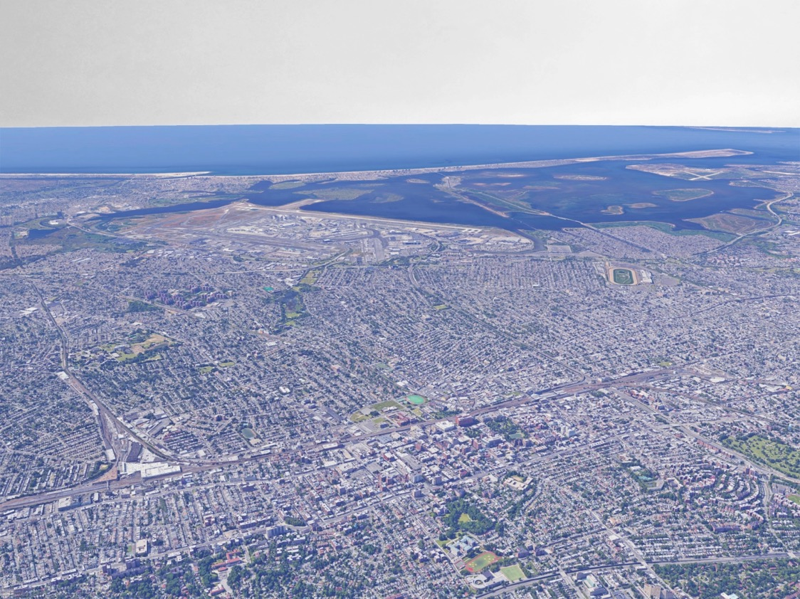
Jamaica, Queens
A business & cultural hub with ties to neighboring communities & JFK airport

Slide 5
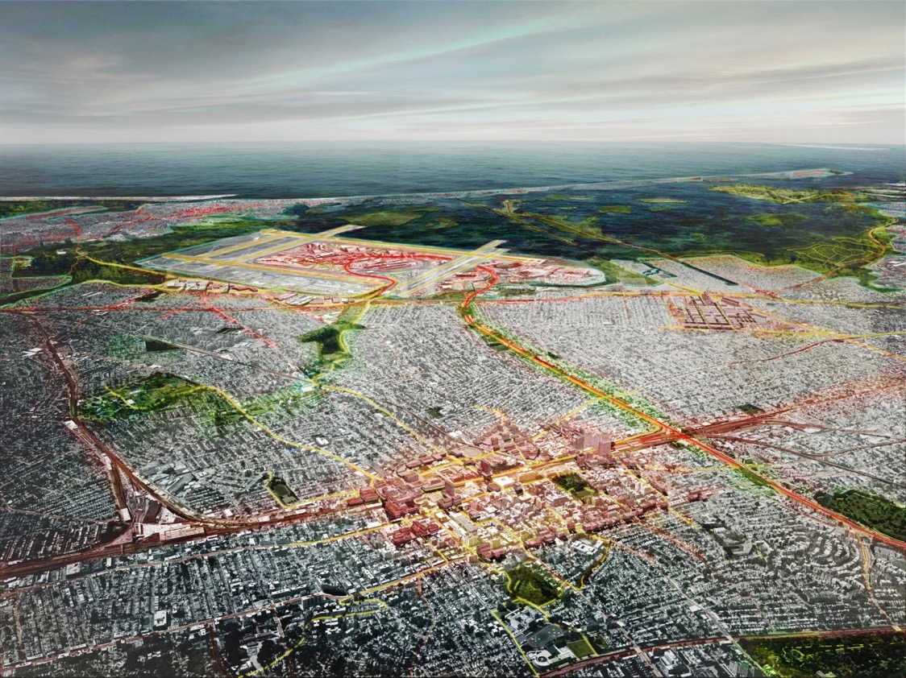
Jamaica, Queens
A business & cultural hub with ties to neighboring communities & JFK airport

Slide 6
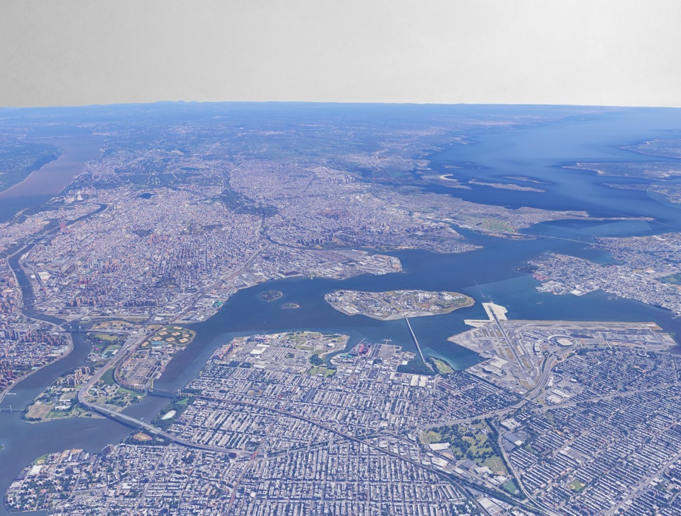
Inner Long Island Sound
A healthy place to live & work
Notes:
Sustain and broaden prosperity

Slide 7
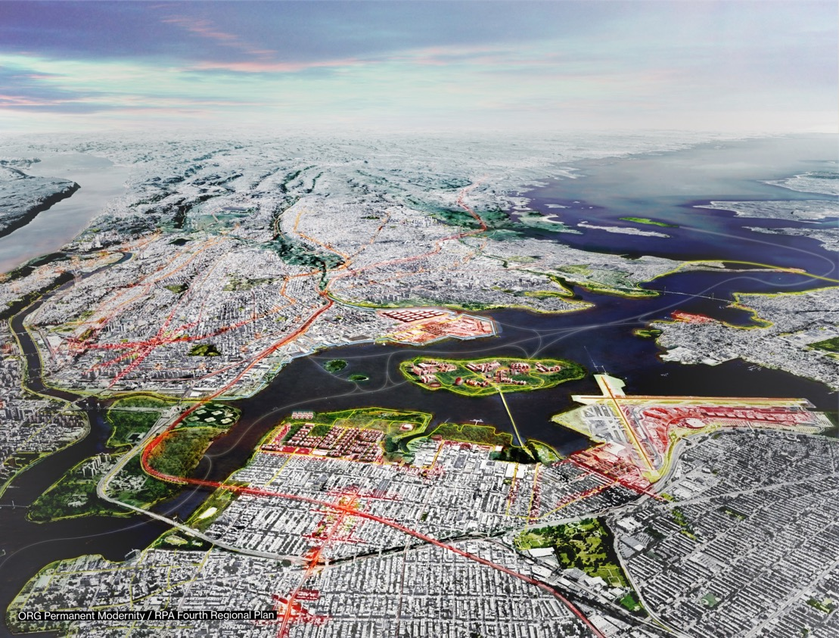
Inner Long Island Sound
A healthy place to live & work

Slide 8
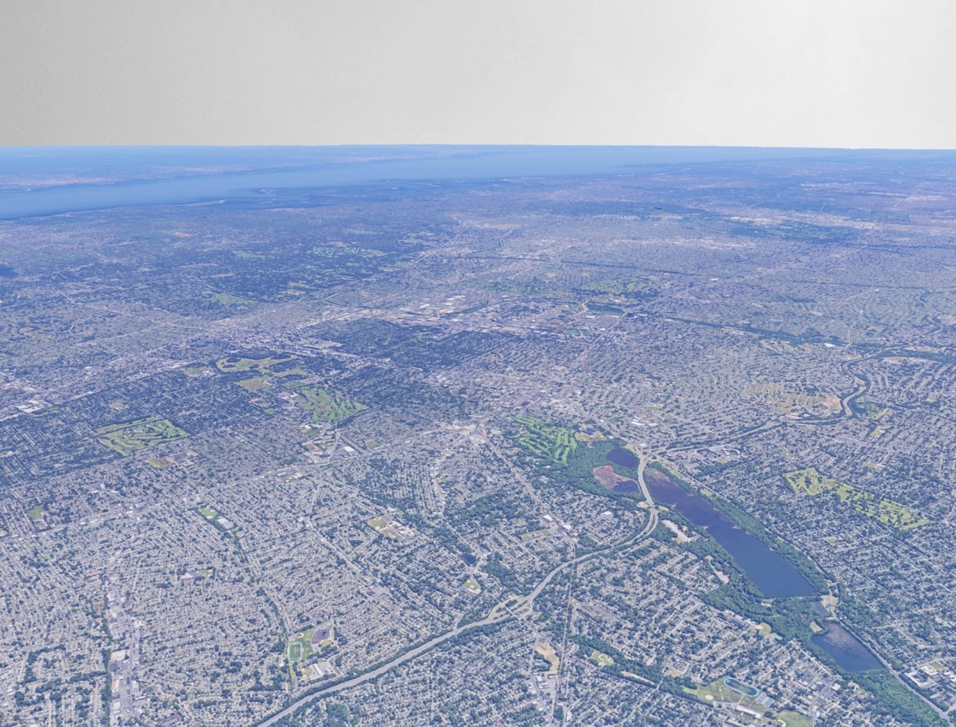
Nassau Hub, Long Island
New transit links for a diverse suburb

Slide 9
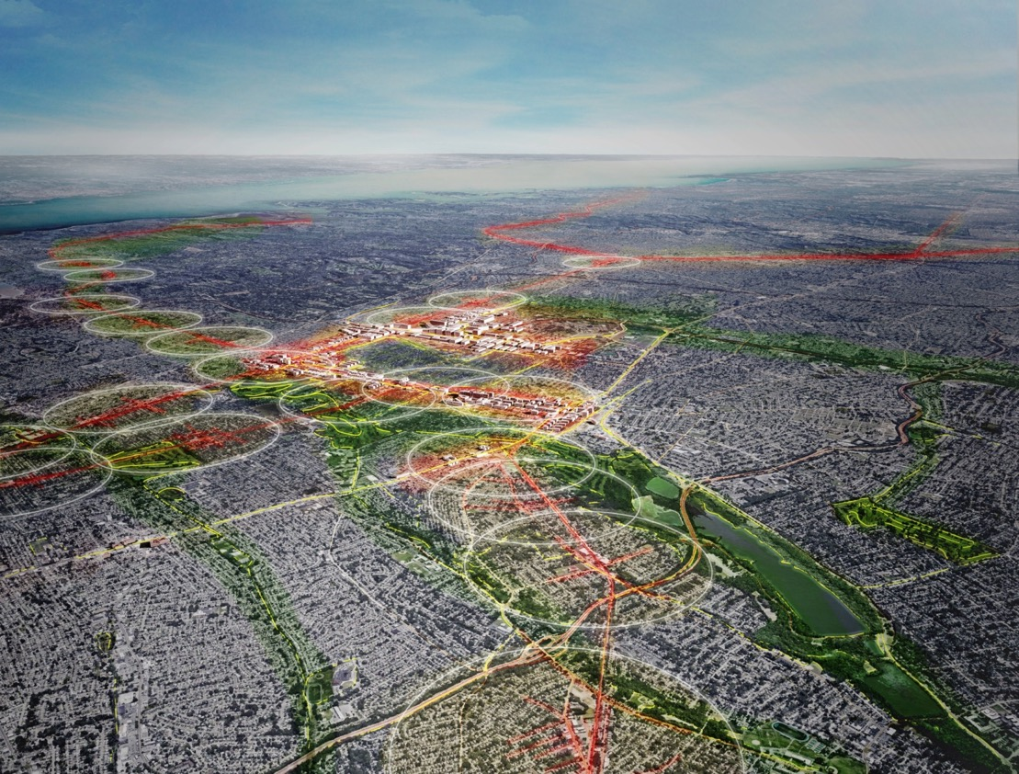
Nassau Hub, Long Island
New transit links for a diverse suburb

Slide 10

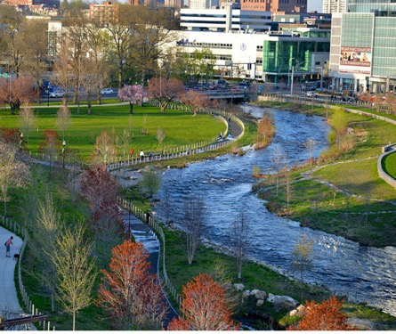
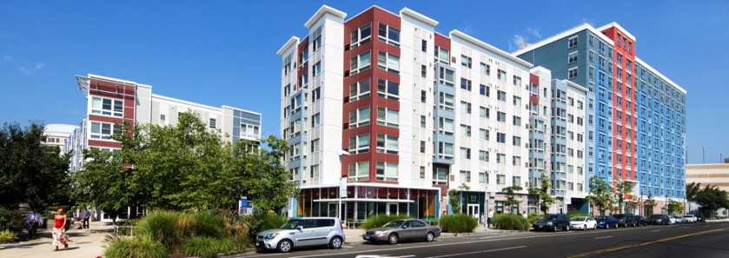
Stamford, Connecticut
A dynamic regional center
Notes:
In a lot of ways, Stamford has fulfilled the promise of the concept of regional centers put forward in the Second Regional Plan-
What’s next for Stamford?
- Addressing gentrification/displacement pressure
- What needs to be done to implement needed improvements on the New Haven Line
- How is this coastal city dealing with impacts of climate change?

Slide 11
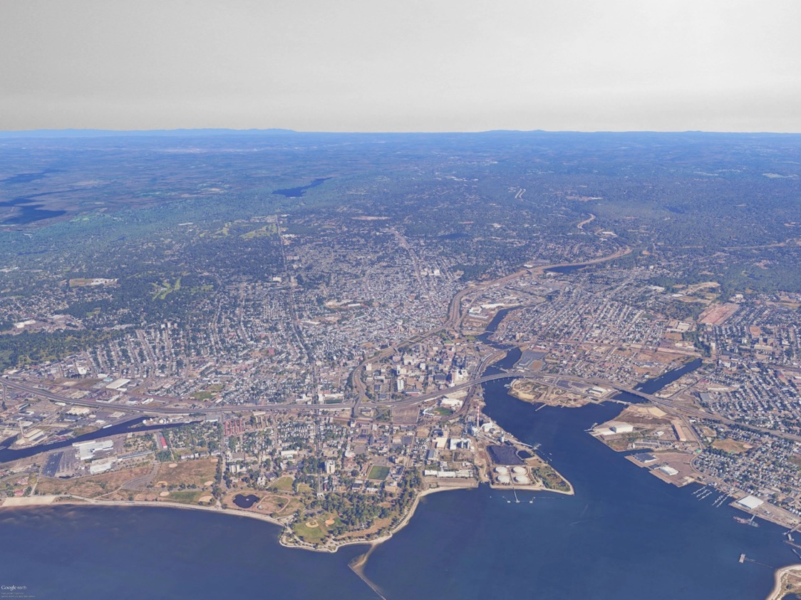
Bridgeport, Connecticut
A green & healthy city on the Northeast Corridor

Slide 12
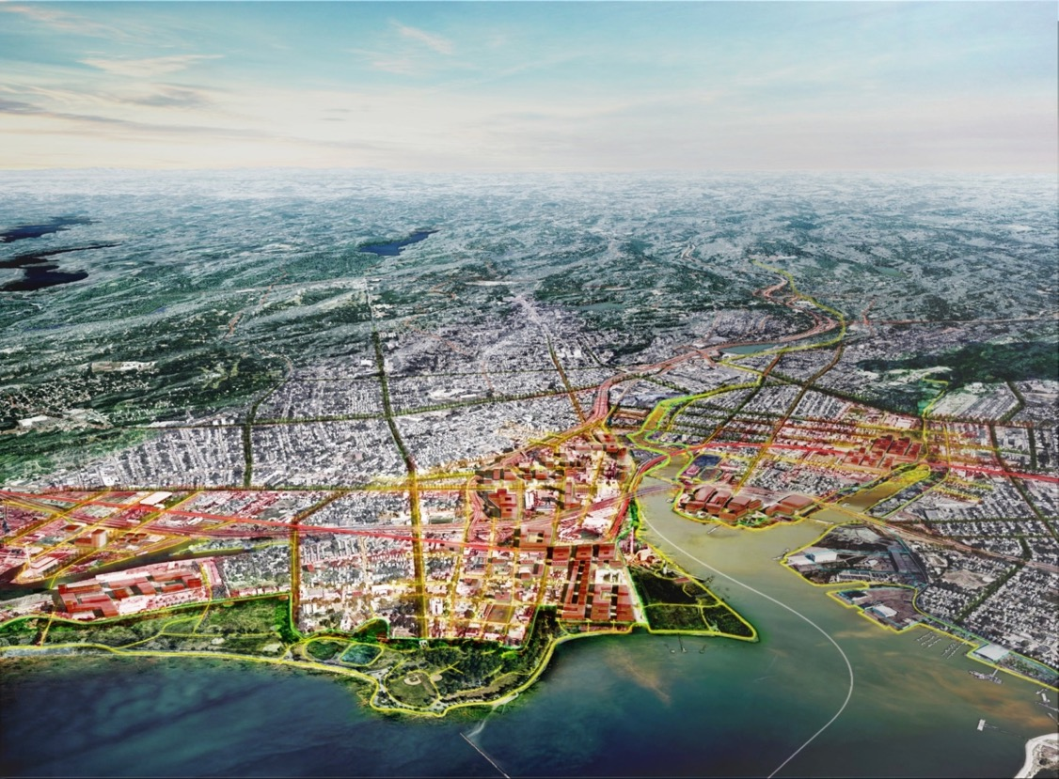
Bridgeport, Connecticut
A green & healthy city on the Northeast Corridor

Slide 13
Invest in the Region’s
Flagship Places
Moderator: Hope Knight, President & CEO, Greater Jamaica Development Corporation, @GJDCPrez
Laura Curran, County Executive, Nassau County, New York
Lynn Haig, Director of Planning, Office of Planning & Economic Development, City of Bridgeport, Connecticut, @CityofBptCT
Melissa Mark-Viverito, Senior Advisor, Latino Victory Fund; former New York City Council Speaker, @MMViverito
David Martin, Mayor, Stamford, Connecticut, @StamfordMayor
Notes:
PM / Carnegie

Slide 14
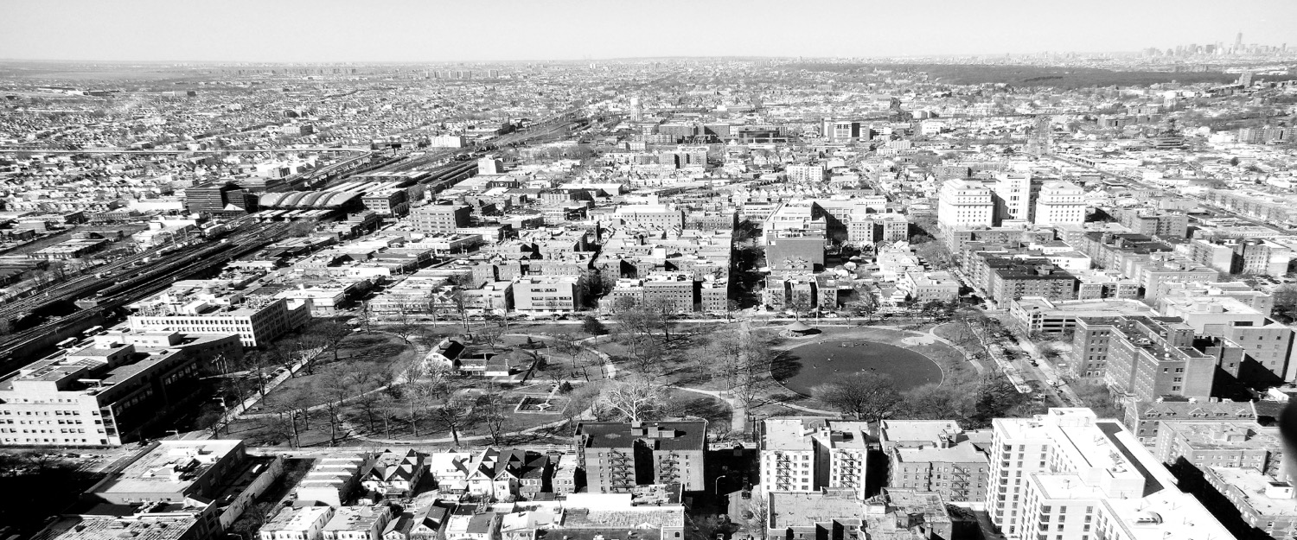
Investing in Jamaica
Reactions to the RPA Fourth Regional Plan

Slide 15
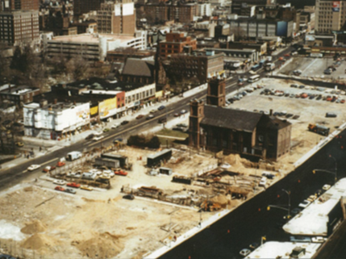
Jamaica circa 1980
Notes:
Section 1: Introduction / reaction to RPA’s vision for Jamaica in 2040

Slide 16
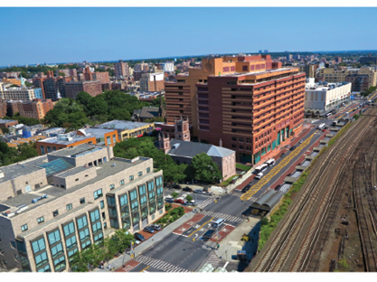
Public and Private Investment
Notes:
Section 2: GJDC’s historic work

Slide 17
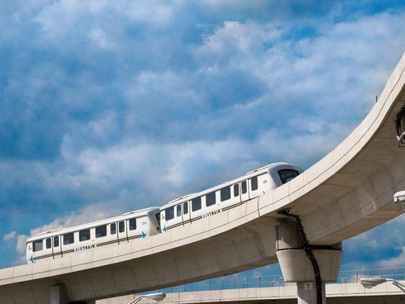
Multi-modal transportation hub
AirTrain to JFK
10 branches of the Long Island Rail Road
44 Bus lines
4 Subway lines (J, Z, E, and F)
Notes:
Section 2: GJDC’s historic work

Slide 18
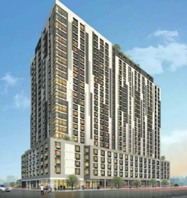
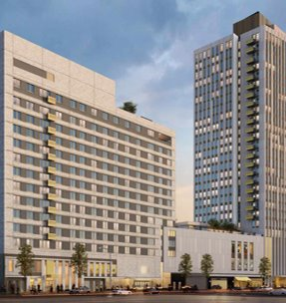
Mixed-Income Housing
Alvista Towers
Artimus Construction
380 apartments
The Crossing at Jamaica Station
BRP Companies
669 apartments
Notes:
Section 3: GJDC’s work facilitating the development of affordable housing

Slide 19
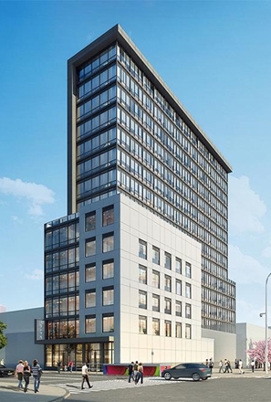
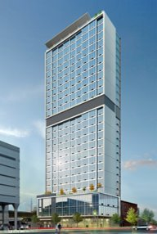
Hospitality Hub
Hampton Inn and Suites
242 rooms
Hilton Garden Inn
225 rooms
Notes:
Section 4: GJDC’s work facilitating the development of amenities

Slide 20
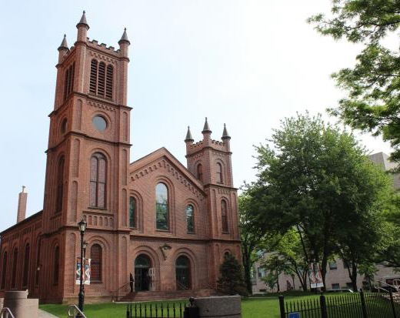
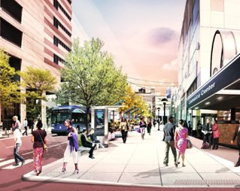
Creative Placemaking
Notes:
Section 5: GJDC’s goal of attracting anchor office tenants

Slide 21
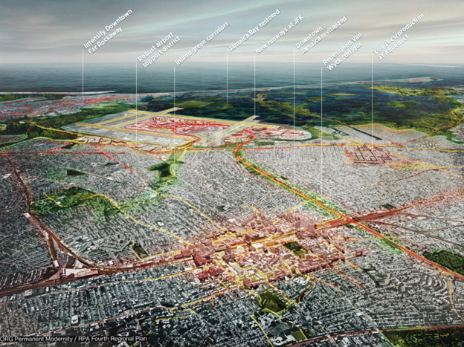
Jamaica 2040
Notes:
Conclusion

Slide 22
Inner Sound

Slide 23
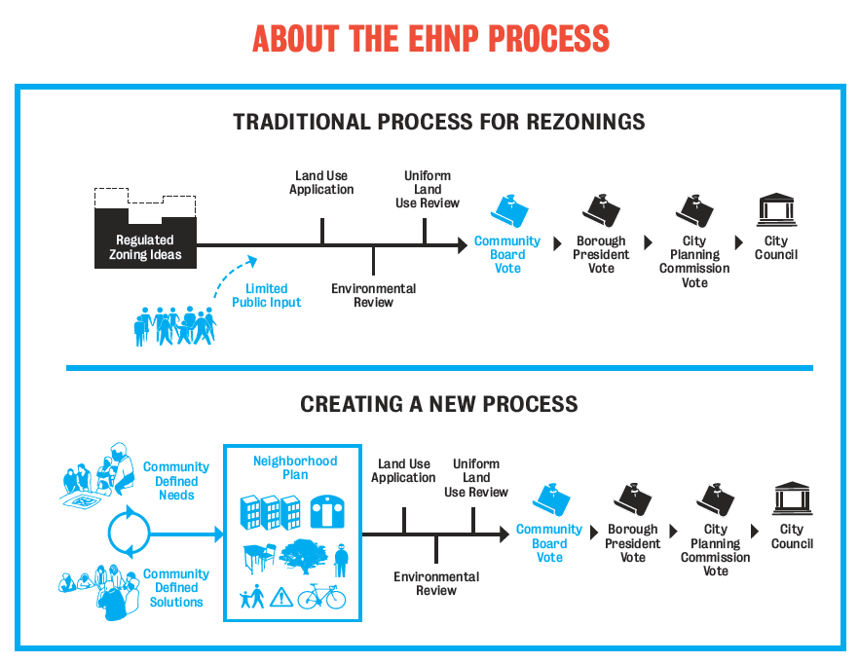

Slide 24
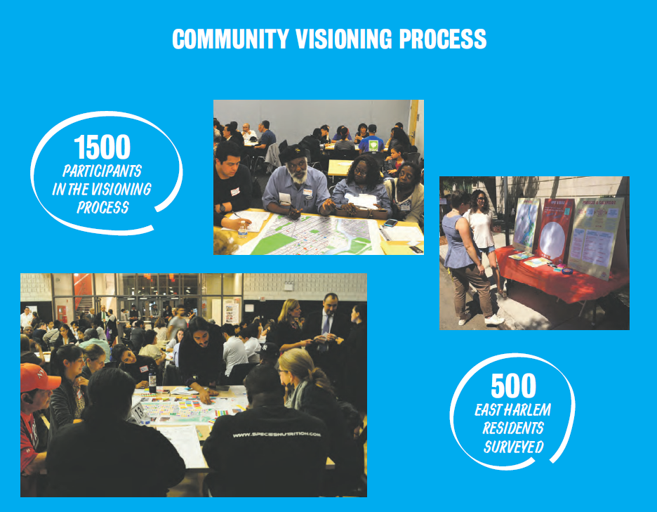

Slide 25
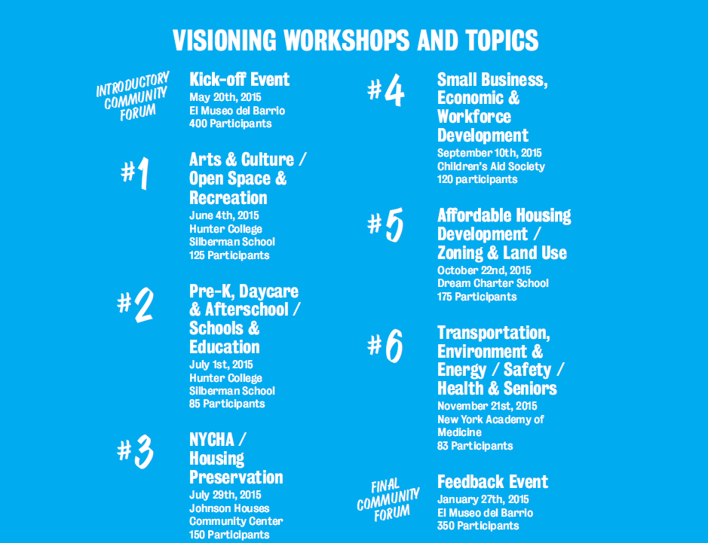

Slide 26
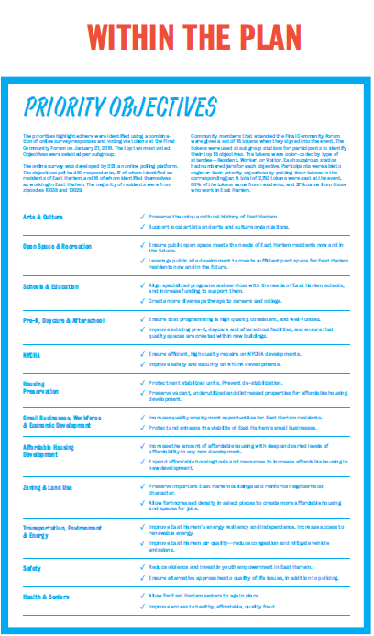

Slide 27
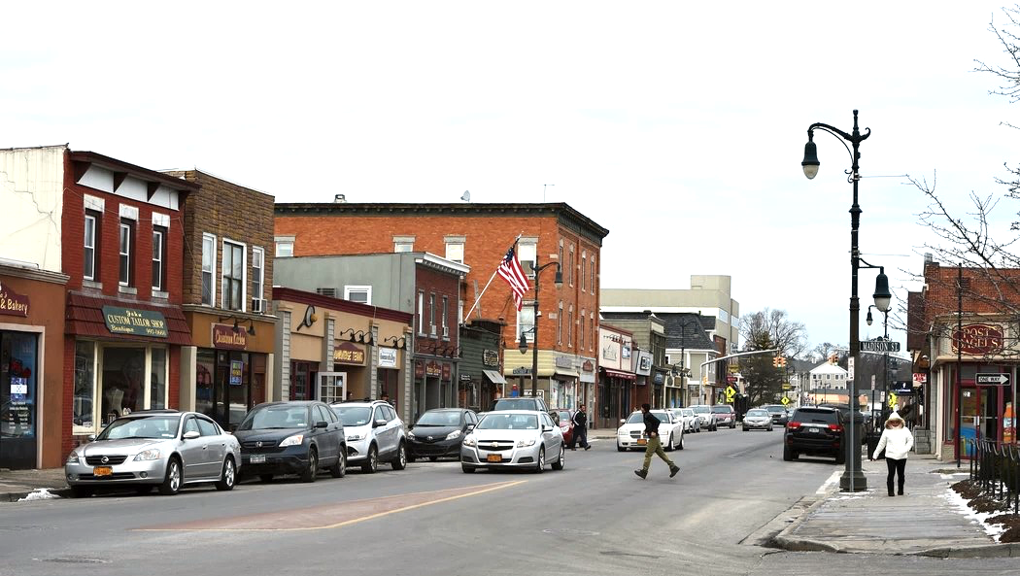

Investing in the Region’s Flagship Places
Nassau County, NY
Presented by Nassau County Executive Laura Curran
RPA Assembly ● April 27, 2018
Photo Credit: NY Times

Slide 28



RPA and Nassau County’s Shared Vision
  Downtown Development
  Transportation Improvements
  Access to Green Space

Slide 29

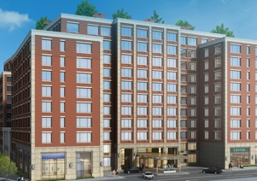
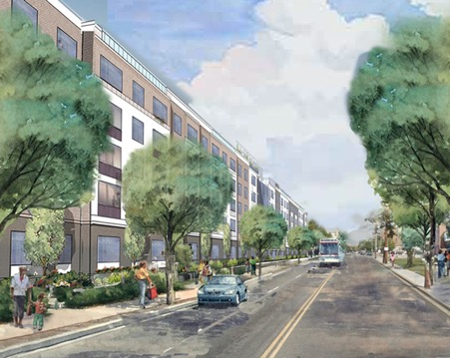
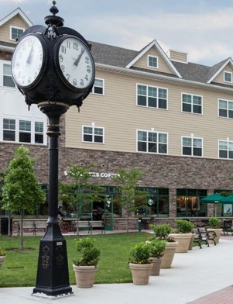
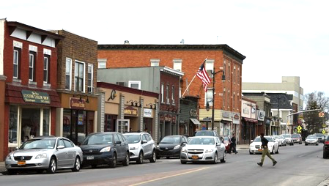

Downtown Development
Hempstead
Mineola
Creating mixed-use housing, walkable neighborhoods
Building on the success of Farmingdale & Mineola
Revitalizing Downtown Hempstead
Westbury
Farmingdale

Slide 30
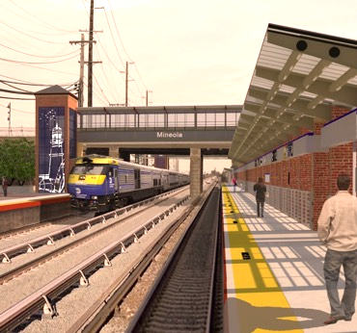
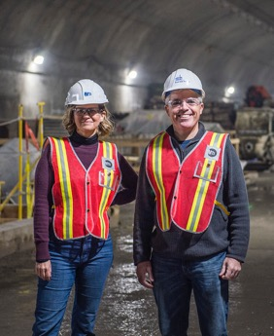
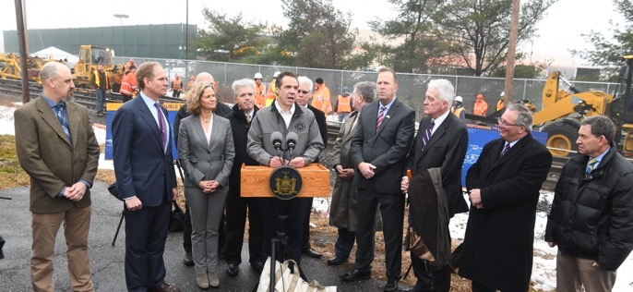

Transportation Improvements
Proposed Mineola
LIRR Station
East Side Access
LIRR Regional Investments:
  Third Track (Nassau) & Second Track (Suffolk)
  East Side Access
  Station Improvements
Advancing Third & Second Track
Notes:
Third Track Benefits: Fewer Delays
Faster Commute
Bi-Directional Service
Enhanced Intra-Island Service
Less Crowding

Slide 31
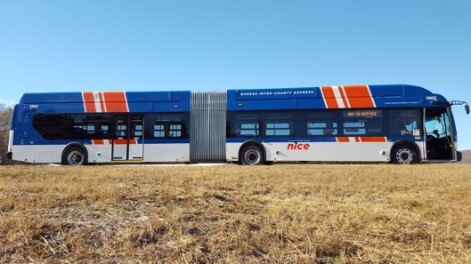
Transportation Improvements
Articulated NICE Bus
New NICE Bus Initiatives
  “LINK” app-based, demand responsive pilot service
  Reorganization of bus stops
  Right-sizing the bus fleet
  Increasing frequency of service
Flexi NICE Bus
Notes:
LINK app-based pilot project
minimization of bus stops to create faster, more efficient routes
right-sizing our fleet of buses (including articulated and “flexi” buses)
increasing frequency of service including nights and weekends

Slide 32
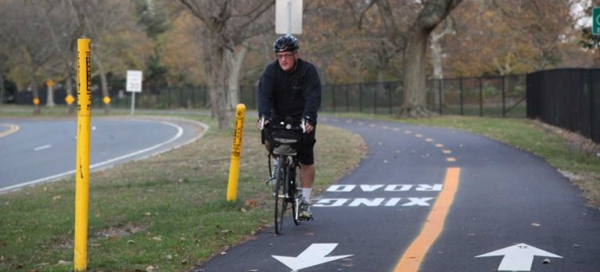
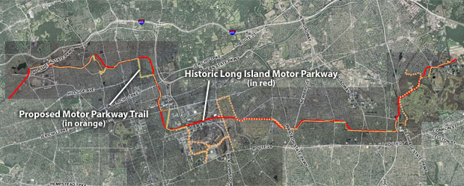
Access to Green Space
New trail segment
Historic LI Motor Parkway Trail
  Multi-use trail across Nassau County
  Connects to other trails & parks
  Supports additional recreational opportunities
Proposed Trail Map
Notes:
Multi-use trailway across Nassau County
Accommodates pedestrians, in-line skaters, cyclists
Will connect to other trail systems and parks
Supports additional recreational opportunities

Slide 33


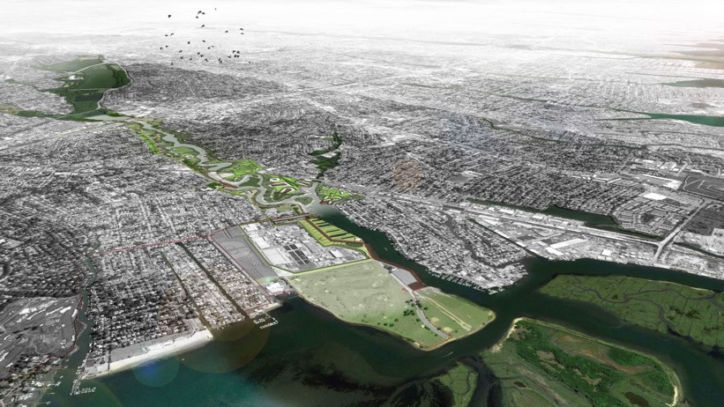
Access to Green Space
Living with the Bay Program
  New “greenway network” connecting Mill River corridor
  Marshland restoration, living shorelines, bulkhead replacements
  Development of social resiliency programs
Mill River Greenway Proposal by Interboro Partners
Notes:
Implementation of a “greenway network” connecting communities throughout Mill River Corridor
Marshland restoration, living shoreline installations, bulkhead improvements
Social resiliency programs including public school education and local job training

Slide 34
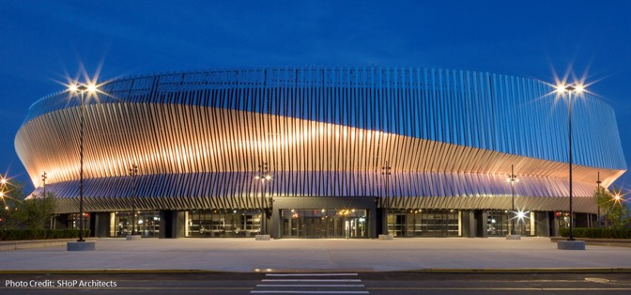
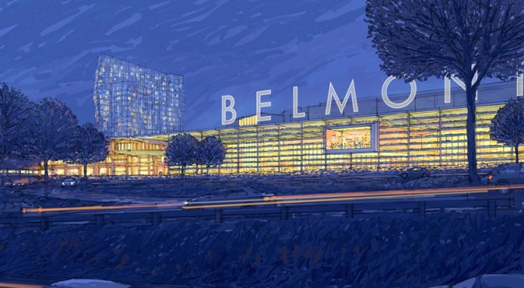
Other Opportunities
Nassau Coliseum/Hub Area
Redevelopment of the Nassau Hub in Uniondale
Redevelopment of Belmont Park in Elmont
Proposed Belmont Park Arena

Slide 35
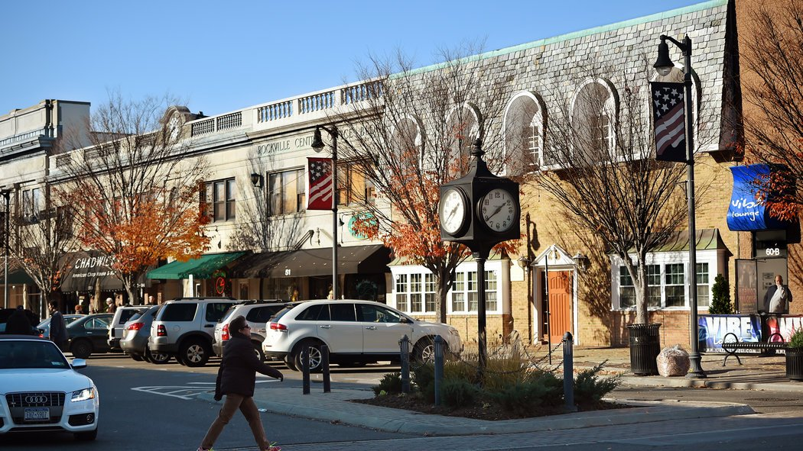

Rockville Centre, NY
Photo Credit: NY Times

Slide 36


Stamford, CT
Investing in the Region’s Flagship Places

Slide 37
About Stamford
Population of ~130,000 – fastest growing City in Connecticut
Median Household Income of $81,634
4 Fortune 500 Companies
9 Fortune 1000 Companies
Has one of the lowest median ages in the State of CT
  Downward trend in last 5 years
Over 67 languages spoken in our public schools
Time to Grand Central on express train: 47 minutes

Slide 38
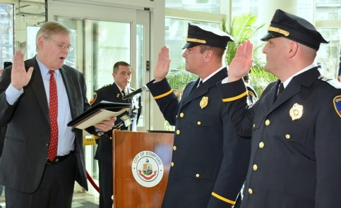
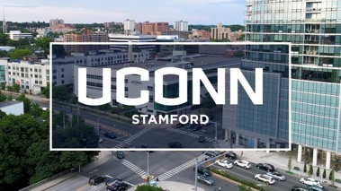

What Businesses Want in a Location
Proximity
Workforce
Mobility
Safety
Low Taxes

Slide 39
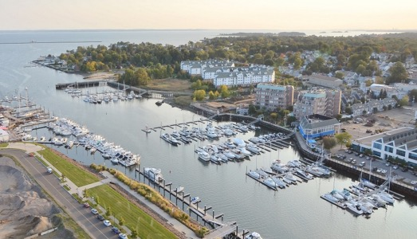

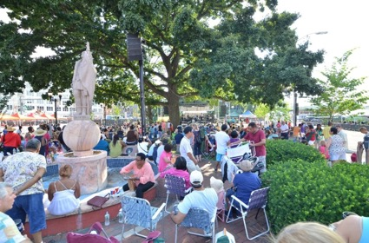

Creating a Place Where People Want to Be
If people want to live here, businesses are more likely to relocate here

Slide 40
Opportunity: Transportation
Ongoing efforts to improve pedestrian safety
  0 homicides in 2017, but 3 pedestrians killed in crashes
Uniform signage at traffic signals
Resynchronizing traffic lights throughout city
  More than 20 years overdue
  Ran into issue that copper wiring was degrading, so all traffic signals have to be rewired with fiber
Enhance bike usage by starting a bike lane network after road repaving
  Newly installed bike racks at the Stamford train station
  Installed new bike hitches in the downtown
Working with state to set up an Autonomous Vehicles pilot corridor

Slide 41
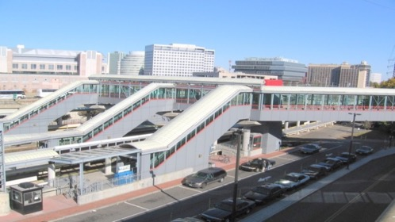
Opportunity: Stamford Transportation Center
Stamford Transportation Center is largest train station between Boston & NYC
  2016 annual ridership of over 8.4 million on Metro-North & 410,000 on Amtrak
Need to coordinate & streamline planning for development & procurement with CTDOT
  Parking Garage
Stamford is looking to establish separate transportation authority with TIF financing

Slide 42
Conclusion
Stamford is the economic engine of Connecticut
Seeing population growth when the state is losing population
New business sectors emerging after 2008 financial crisis
  Consumer Goods & Products –Henkel and Vineyard Vines
  Science & Technology – Gartner and Indeed.com
  Finance – Synchrony & PartnerRe
In order to attract similar companies, need to create an environment where people want to live, work, play
Investment by State and region important to successful, controlled growth

Slide 43
BRIDGEPORT, CT
FLAGSHIP PLACE
THE FOURTH REGIONAL PLAN

Slide 44
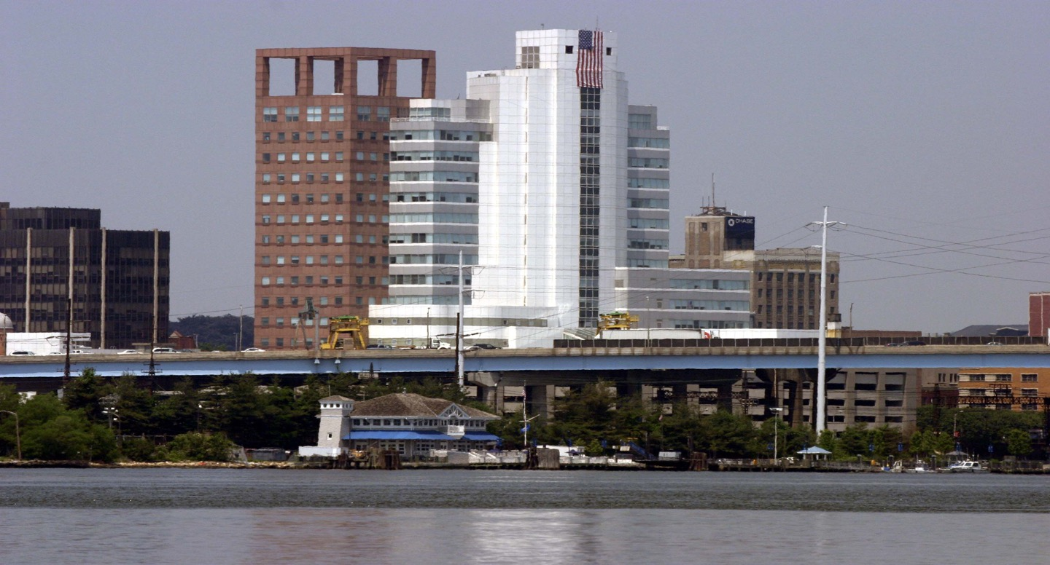

Slide 45


Slide 46


Slide 47
Upgrade Infrastructure for Resilience

Slide 48


Slide 49


Slide 50
Protect Low-Income Residents from
Displacement and Homelessness

Slide 51


Slide 52


Slide 53


Slide 54
Partner with Anchor Institutions and
Restore Regional Job Centers

Slide 55



Slide 56



Slide 57


Slide 58
be BOLD today to be
GREAT tomorrow

Slide 59
Invest in the Region’s
Flagship Places
Moderator: Hope Knight, President & CEO, Greater Jamaica Development Corporation, @GJDCPrez
Laura Curran, County Executive, Nassau County, New York
Lynn Haig, Director of Planning, Office of Planning & Economic Development, City of Bridgeport, Connecticut, @CityofBptCT
Melissa Mark-Viverito, Senior Advisor, Latino Victory Fund; former New York City Council Speaker, @MMViverito
David Martin, Mayor, Stamford, Connecticut, @StamfordMayor
Notes:
PM / Carnegie

